Slide 1
Benefits for me, benefits for the business: why jobsharing works
Beth Chaudhary, Head of Smart Energy Policy, BEIS
Vision and Objectives
EWIRE 2017
Notes:
Cover style 1 (delete if using cover style 2)

Slide 2
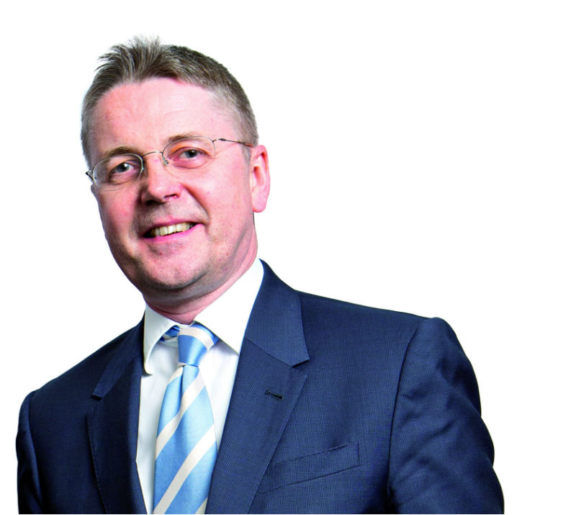
“Any role can be job-shared!

Slide 3
What makes a good job share partnership?
Shared objectives and shared success
Mutual trust and respect
Equivalent experience and ambition
Equal level of commitment
A united front

Slide 4
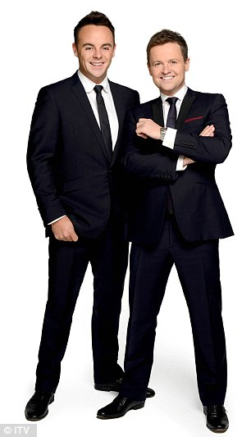
How it works – two minds are better than one

Slide 5
Benefits to me – benefits to the business
Civil Service People Survey 2017 – engagement index
☺
☺
☺

Slide 6
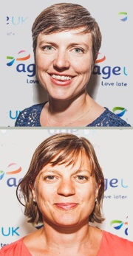
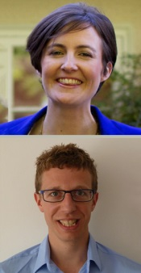
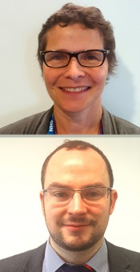
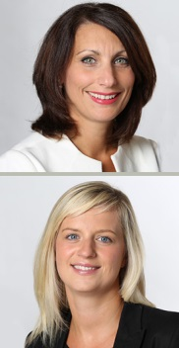
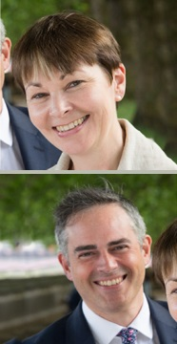
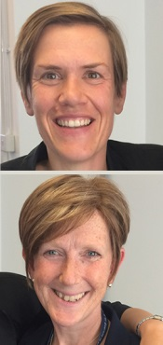
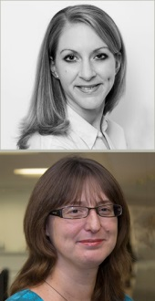
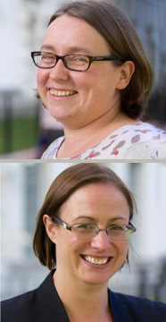
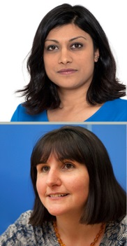
Smart and flexible in every sense
Time wise – 2017 Part time power top 50
AMANDA TUKE &
SAM TAYLOR
Croydon Council
Head of Partnerships &
Children’s Integrated
Commissioning
LIZ DAVIDSON &
IAN SHEPHERD
Home Office
Deputy Director,
Police Integrity
ANGELA KITCHING &
HANNAH PEARCE
Age UK
Head of External Affairs
ALIX AINSLEY &
CHARLOTTE CHERRY
Lloyds Banking Group
HR Director
OLIVIA MCLEOD &
HELEN CAMERON
Scottish Government
Director for Children
and Families
CAROLINE LUCAS &
JONATHAN BARTLEY
Green Party
Joint Leaders
CAROLINE PUSEY
HEATHER MCNAUGHTON
Ministry of Defence
Director
Service Personnel
HANNAH BLOXHAM &
JULIE TAYLOR,
DWP
HR Director
ANUSHKA ASTHANA
& HEATHER STEWART
The Guardian
Joint Political Editor

Slide 7
Thank you

